Slide 1

Deployment models and private cloud platform construction

Slide 2
Intended learning outcomes
After completing this topic, you will be able to:
Understand different cloud deployment models
Use the cloud computing virtualization technologies to construct private cloud platform

Slide 3
Private cloud vs Public cloud (1)
Private cloud
dedicated to the needs and goals of a single organization
Public cloud
Delivers services to multiple organizations

Slide 4
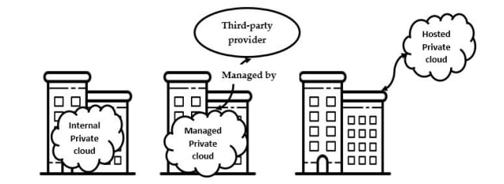
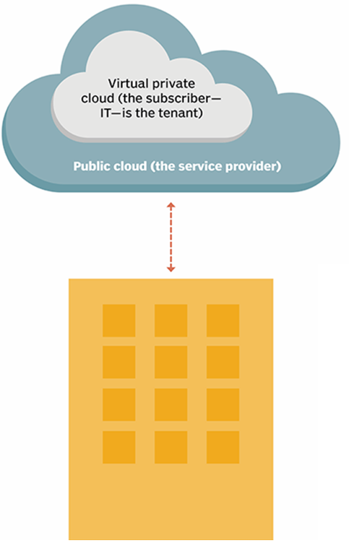
Private cloud types

Slide 5
Disadvantages of a private cloud
Can bring some complexity to an enterprise
Private cloud technologies, such as increased automation and user self-service, typically require an IT team to re-architect some of its data center infrastructure, as well as adopt additional management tools
An organization might have to adjust or even increase its IT staff to successfully implement a private cloud

Slide 6
Disadvantages of a private cloud
Higher cost
When a business owns its private cloud, it often bears all the costs involved
Acquisition
Deployment
Support
Maintenance
In hosted private clouds the user does not pay for the infrastructure but pays for the service
This can end up being more expensive than the upfront cost of complete ownership in the long run, and sacrifices some of the control over maintenance that complete ownership guarantees

Slide 7
Private cloud vendors
Hewlett Packard Enterprise (HPE)
the Helion Cloud Suite software, Helion CloudSystem hardware, Helion Managed Private Cloud and Managed Virtual Private Cloud services
Vmware
enables virtualization with its vSphere product, and offers its vRealize Suite cloud management platform and Cloud Foundation Software-Defined Data Center platform for private clouds
Dell EMC
offers virtual private cloud services, as well as cloud management and cloud security software
Oracle
offers its Private Cloud Appliance X8, which enables compute and storage capabilities optimized for private cloud deployment
IBM
offers private cloud hardware, along with IBM Cloud Managed Services, cloud security tools and cloud management and orchestration tools
Red Hat
offers private cloud deployment and management with a range of platforms, including OpenStack and Gluster Storage, as well as Red Hat Cloud Suite for management and development

Slide 8
Constructing a private cloud
Cloud infrastructure
components needed for cloud computing
the basic elements of cloud infrastructure are the same whether you have a private cloud, public cloud, or hybrid cloud
Operating system+ a variety of bare-metal, virtualization, or container software that abstract, pool, and share scalable resources across a network
The IT staff that is equipped to manage private cloud environments

Slide 9
Cloud engineering professionals
Cloud engineer
Cloud architect

Slide 10
Cloud architect role
Creating a well-informed cloud strategy and managing the adaptation process
Evaluating cloud applications, hardware, and software
Designing and implementing cloud computing solutions
designing the cloud infrastructure
designing the cloud application architecture
designing the cloud security architecture

Slide 11
Cloud professionals key skills
Know the language of business and domain knowledge
Understand the conceptual, logical and physical architecture
Master various cloud technologies, frameworks, and platforms
Implement the solutions for quality of cloud services, e.g. HA, DR, scaling, performance
Work on the security at multiple levels
Develop applications for flexible deployment, provisioning, and management
Leverage open source packages and products
Apply agile and lean principles in design and construction

Slide 12
Cloud professionals technical skills
Good knowledge of at least one operating system
Linux, Unix, Solaris, Ubuntu, Windows
Good understanding of networking
TCP/IP, IP addresses, HTTP, DNS
Computer programming languages
at least a minimal understanding of a programming or scripting language (helpful)
Security
a high-level understanding of key security concepts, initial knowledge of some basic security concepts, such as firewalls

Slide 13
Certified Cloud Architect - AWS
AWS Certified Solutions Architect – Associate
This certification validates technical expertise in designing and deploying systems on the AWS platform

Slide 14
Certified Cloud Architect – Microsoft Azure
Microsoft Azure Solutions Architect
The certification requires expertise in compute, network, storage, and security to design solutions that run on Azure
Two exams:
AZ-300 Exam: Technologies for Microsoft Azure Architects
AZ-301 Exam: Designing a Microsoft Azure Architecture

Slide 15
Private cloud architecture
Single-tenant/isolated design but based on the same technologies as other clouds
Technologies that enable the customer to provision and configure virtual servers and computing resources on demand in order to quickly and easily (or even automatically) scale in response to spikes in usage and traffic, to implement redundancy for high availability, and to optimize utilization of resources overall

Slide 16
Private cloud enabling technologies
These technologies include the following:
Virtualization
Management software
Automation

Slide 17
Private cloud enabling technologies - virtualization
Virtualization enables IT resources to be abstracted from their underlying physical hardware and pooled into unbounded resource pools of computing, storage, memory, and networking capacity that can then portioned among multiple virtual machines (VMs), containers, or other virtualized IT infrastructure elements
By removing the constraints of physical hardware, virtualization enables maximum utilization of hardware, allows hardware to be shared efficiently across multiple users and applications, and makes possible the scalability, agility, and elasticity of the cloud

Slide 18
Private cloud enabling technologies – management software
Management software gives administrators centralized control over the infrastructure and applications running on it
This makes it possible to optimize security, availability, and resource utilization in the private cloud environment

Slide 19
Private cloud enabling technologies - automation
Automation speeds tasks—such as server provisioning and integrations—that would otherwise need to be performed manually and repeatedly
Automation reduces the need for human intervention, making self-service resource delivery possible

Slide 20
Cloud architecture
Cloud architecture is how individual technologies are integrated to create clouds
How all the components and capabilities necessary to build a cloud are connected in order to deliver an online platform on which applications can run

Slide 21
Constructing a private cloud
Cloud infrastructure
components needed for cloud computing
the basic elements of cloud infrastructure are the same whether you have a private cloud, public cloud, or hybrid cloud.
Operating system+ a variety of bare-metal, virtualization, or container software that abstract, pool, and share scalable resources across a network.
The IT staff that is equipped to manage private cloud environments

Slide 22
Private cloud - a virtualized pool of resources
To enable multiple workloads to run on the same physical server, we need to virtualize the resources
We will use virtualization software to achieve that

Slide 23
Example - setting up a virtual machine server

Slide 24
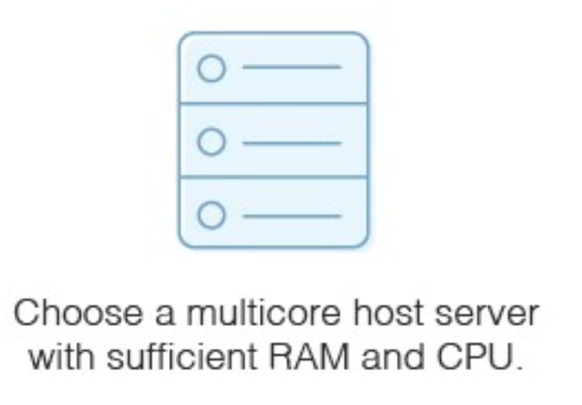
Physical hardware
Physical hardware with appropriate resources
The capacity of your physical host machine matters
each VM will need RAM and CPU

Slide 25
Storage
Necessary if you don’t have a storage area network for the virtual server images
The host server will need sufficient disks to hold this storage
SATA drives
SAS drives

Slide 26
Hypervisor
Use virtualization software (hypervisor) to set up virtual machine server
Hyper-V
Vmware
VirtualBox
Citrix XenServer
Hypervisor types
bare-metal hypervisors
installed directly on the hardware
may run slightly faster, but they’re a bit trickier to set up and use than a hosted hypervisor
hosted hypervisors
installed on an already-existing operating system installed on the host machine
Follow the instructions on the hypervisor itself to set up and provision a virtual server. Hosted hypervisors are much like any computer application because they have a setup wizard with easy instructions.

Slide 27
Configure Virtual Machines
Check the default values for the virtual machine to ensure it will suffice for your purposes
Choose
What guest operating system you want to run
Where the virtual machine’s files will be stored
The types of network connection you want to set up for the virtual machine
Decide whether to allocate all the disk space for the virtual machine when you create it, or whether you want it to take disk space dynamically as needed.
You can configure three types of virtual machine resources
Hardware it has access to
Power management operating system options
Resource configuration
CPU configuration
Hyperthreading
Disk settings
Memory

Slide 28
Example - setting up a virtual machine server

Slide 29
Private Cloud Solutions
Allow companies to architect a data center using software-defined networking (SDN) and virtualization (VMs)
Private cloud solutions come from
proprietary software developers like Microsoft, VMware, and Nutanix
enterprise-grade open source solutions available from Red Hat and others

Slide 30
VMware Private Cloud
VMware - a leading international cloud infrastructure company
provides virtualization solutions since 1998
VMware Private cloud - a virtualized pool of resources allocated on-demand
Private cloud is able to easily switch between virtual machines to keep everything running
It can also create endless virtual machines based on your underlying hardware

Slide 31
VMware vSphere®
Uses virtualization to transform data centers into simplified cloud computing infrastructures

Slide 32
Virtualization Basics
A virtual machine is a software computer that, like a physical computer, runs an operating system and applications
The hypervisor serves as a platform for running virtual machines and allows for the consolidation of computing resources.
Each virtual machine contains its own virtual, or software-based, hardware, including a virtual CPU, memory, hard disk, and network interface card.

Slide 33
VMware vSphere®
The two core components
VMware ESXi™
The hypervisor on which you create and run virtual machines
VMware vCenter Server®
A service that acts as a central administrator for ESXi hosts that are connected on a network

Slide 34
Physical Topology of vSphere Data Center
A typical VMware vSphere data center consists of physical building blocks such as
x86 virtualization servers - ESXi Hosts
storage networks and arrays
IP networks
a management server - vCenter Server
desktop clients

Slide 35
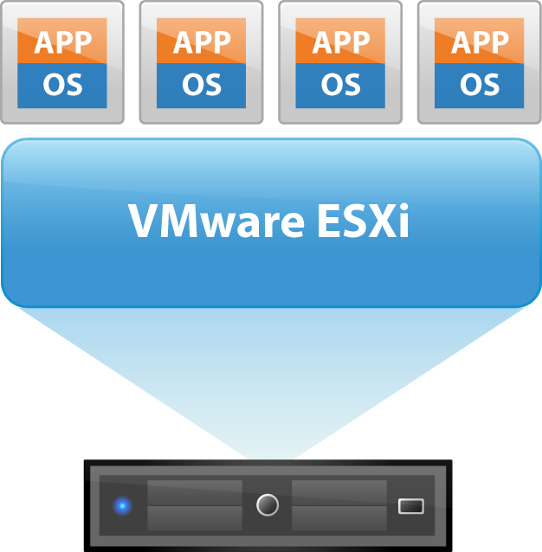
ESXi - the hypervisor in a vSphere environment
Installed on physical or virtual hardware in a virtualized data center, and acts as a platform for virtual machines
Provides physical hardware resources dynamically to virtual machines to support the operation of the virtual machines
Allows virtual machines to operate with a degree of independence from the underlying physical hardware
For example, a virtual machine can be moved from one physical host to another, or its virtual disks can be moved from one type of storage to another, without affecting the functioning of the virtual machine

Slide 36
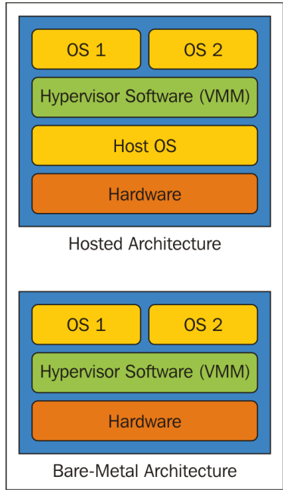
Hypervisor types

Slide 37
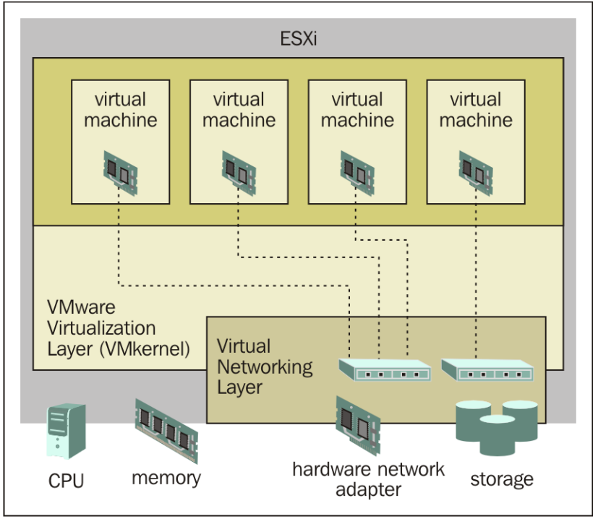
ESXi
An enterprise-class, type-1 hypervisor (bare-metal)
As a type-1 hypervisor, ESXi is not a software application that is installed on an operating system (OS)
Instead, it includes and integrates vital OS components, such as a kernel

Slide 38
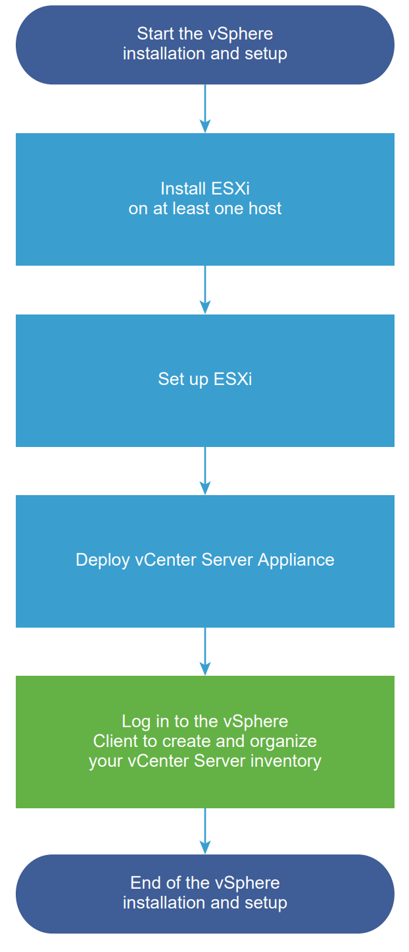
VSphere installation and setup
You can install and set up ESXi on your physical hardware so that it acts as a platform for virtual machines
After ESXi is installed and set up, you can manage the host by using the vSphere Client and vCenter Server, license the host, and back up your ESXi configuration
You can also use the VMware Host Client to connect directly to the ESXi host and to manage it

Slide 39
The vCenter Server appliance
The vCenter Server appliance is a preconfigured virtual machine that is optimized for running vCenter Server and the associated services

Slide 40
Deploying the vCenter Server appliance
You can deploy the vCenter Server appliance to manage your vSphere environment
You can deploy the vCenter Server appliance on ESXi hosts or on vCenter Server instances
During the deployment, you can choose the vCenter Server appliance size for your vSphere environment size and the storage size for your database requirements

Slide 41
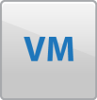


vCenter Server (1)
vCenter Server provides a single point of control to the data center
You can pool and manage the resources of multiple hosts
It unifies the resources from the individual computing servers to be shared among virtual machines in the entire data center
It provides essential data center services such as
Access control
Performance monitoring
Configuration
VMware vCenter Server

Slide 42
vCenter Server (2)
Allows you to monitor and manage your physical and virtual infrastructure
It manages the assignment of virtual machines to the ESXi hosts and the assignment of resources to the virtual machines within a given computing server
These assignments are based on the policies that the system administrator sets
VMware vCenter Server

Slide 43
vCenter Server (3)
A single point of control doesn’t mean a single point of failure
Compute servers continue to function even if vCenter Server becomes unreachable (for example, if the network is severed)
The ESXi hosts can be managed separately and continue to run the virtual machines assigned to them based on the resource assignment that was last set
After connection to vCenter Server is restored, it can manage the data center as a whole again
VMware vCenter Server

Slide 44
Choosing cloud deployments
Public cloud?
Private cloud?
Hybrid cloud?

Slide 45
Making the choice to adopt private cloud
Choosing private cloud over public mainly boils down to two things
budgeting (choosing CAPEX over OPEX)
control (in terms of security and privacy)

Slide 46
Budgeting
Capital Expenditures (CapEx)
Purchases of significant goods or services that will be used to improve a company’s performance in the future
Manufacturing plants, equipment, and machinery
Building improvements
Computers
Vehicles and trucks
…
Operating Expenses (OpEx)
The costs that a company incurs for running its day-to-day operations
Rent and utilities
Wages and salaries
…

Slide 47
Budgeting issues
Which cloud costs more?
You usually pay for what you use in a public cloud, though some public clouds don't charge tenants.
Whoever set up a private cloud is usually responsible for purchasing or renting new hardware and resources to scale up
Hybrid clouds can include any on-premises, off-premises, or provider's cloud to create a custom environment that suits your cost requirements

Slide 48
Budgeting issues
Which cloud has the best resources?
That depends on how you want to spend money. Do you want to incur capital expenses (CapEx) or operating expenses (OpEx)? This is the classic scale-up vs. scale-out question.
Public cloud users seem to have unlimited access to resources, but accessing those resources is usually an operational expense.
Deploying more private cloud resources requires buying or renting more hardware—all capital expenses.
Hybrid clouds give you the option of using operating expenses to scale out or capital expenses to scale up

Slide 49
Control issues
Which cloud is safest?
Public clouds
Tend to have a wider variety of security threats due to multi-tenancy and numerous access points
Often split security responsibilities
infrastructural security can be the provider’s responsibility
workload security can be the tenant's responsibility
Private clouds
Are thought to be more secure because workloads usually run behind the user's firewall
All depends on how strong the user’s own security is
Hybrid cloud
security is made up of the best features of every environment
users and admins can minimize data exposure by moving workloads and data across environments based on compliance, audit, policy, or security requirements

Slide 50
Cloud migration strategy
The decision to deploy a private cloud should be a well-thought out and strategic one
Cloud means something different to every organization, depending on its size, industry, and the nature of the data it deals with
Enterprises need to define and lay out their needs, expectations, and goals clearly before attempting to build a private cloud model

Slide 51
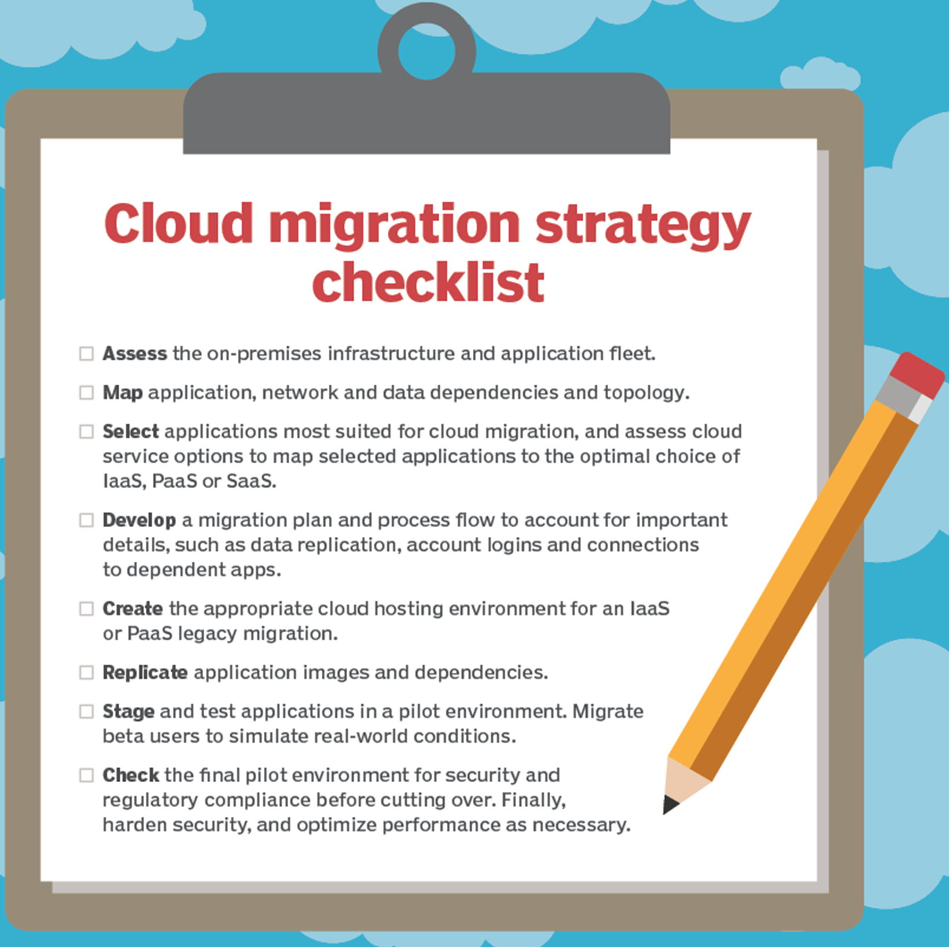

Slide 52
Summary
All private clouds offer an isolated environment but differ on how they are hosted and how much management they receive from the provider
Private clouds are based on the same technologies as public and hybrid clouds
Before adopting cloud technology, companies need to first develop a migration strategy in which they define their needs, expectations, and goals

